Slide 1
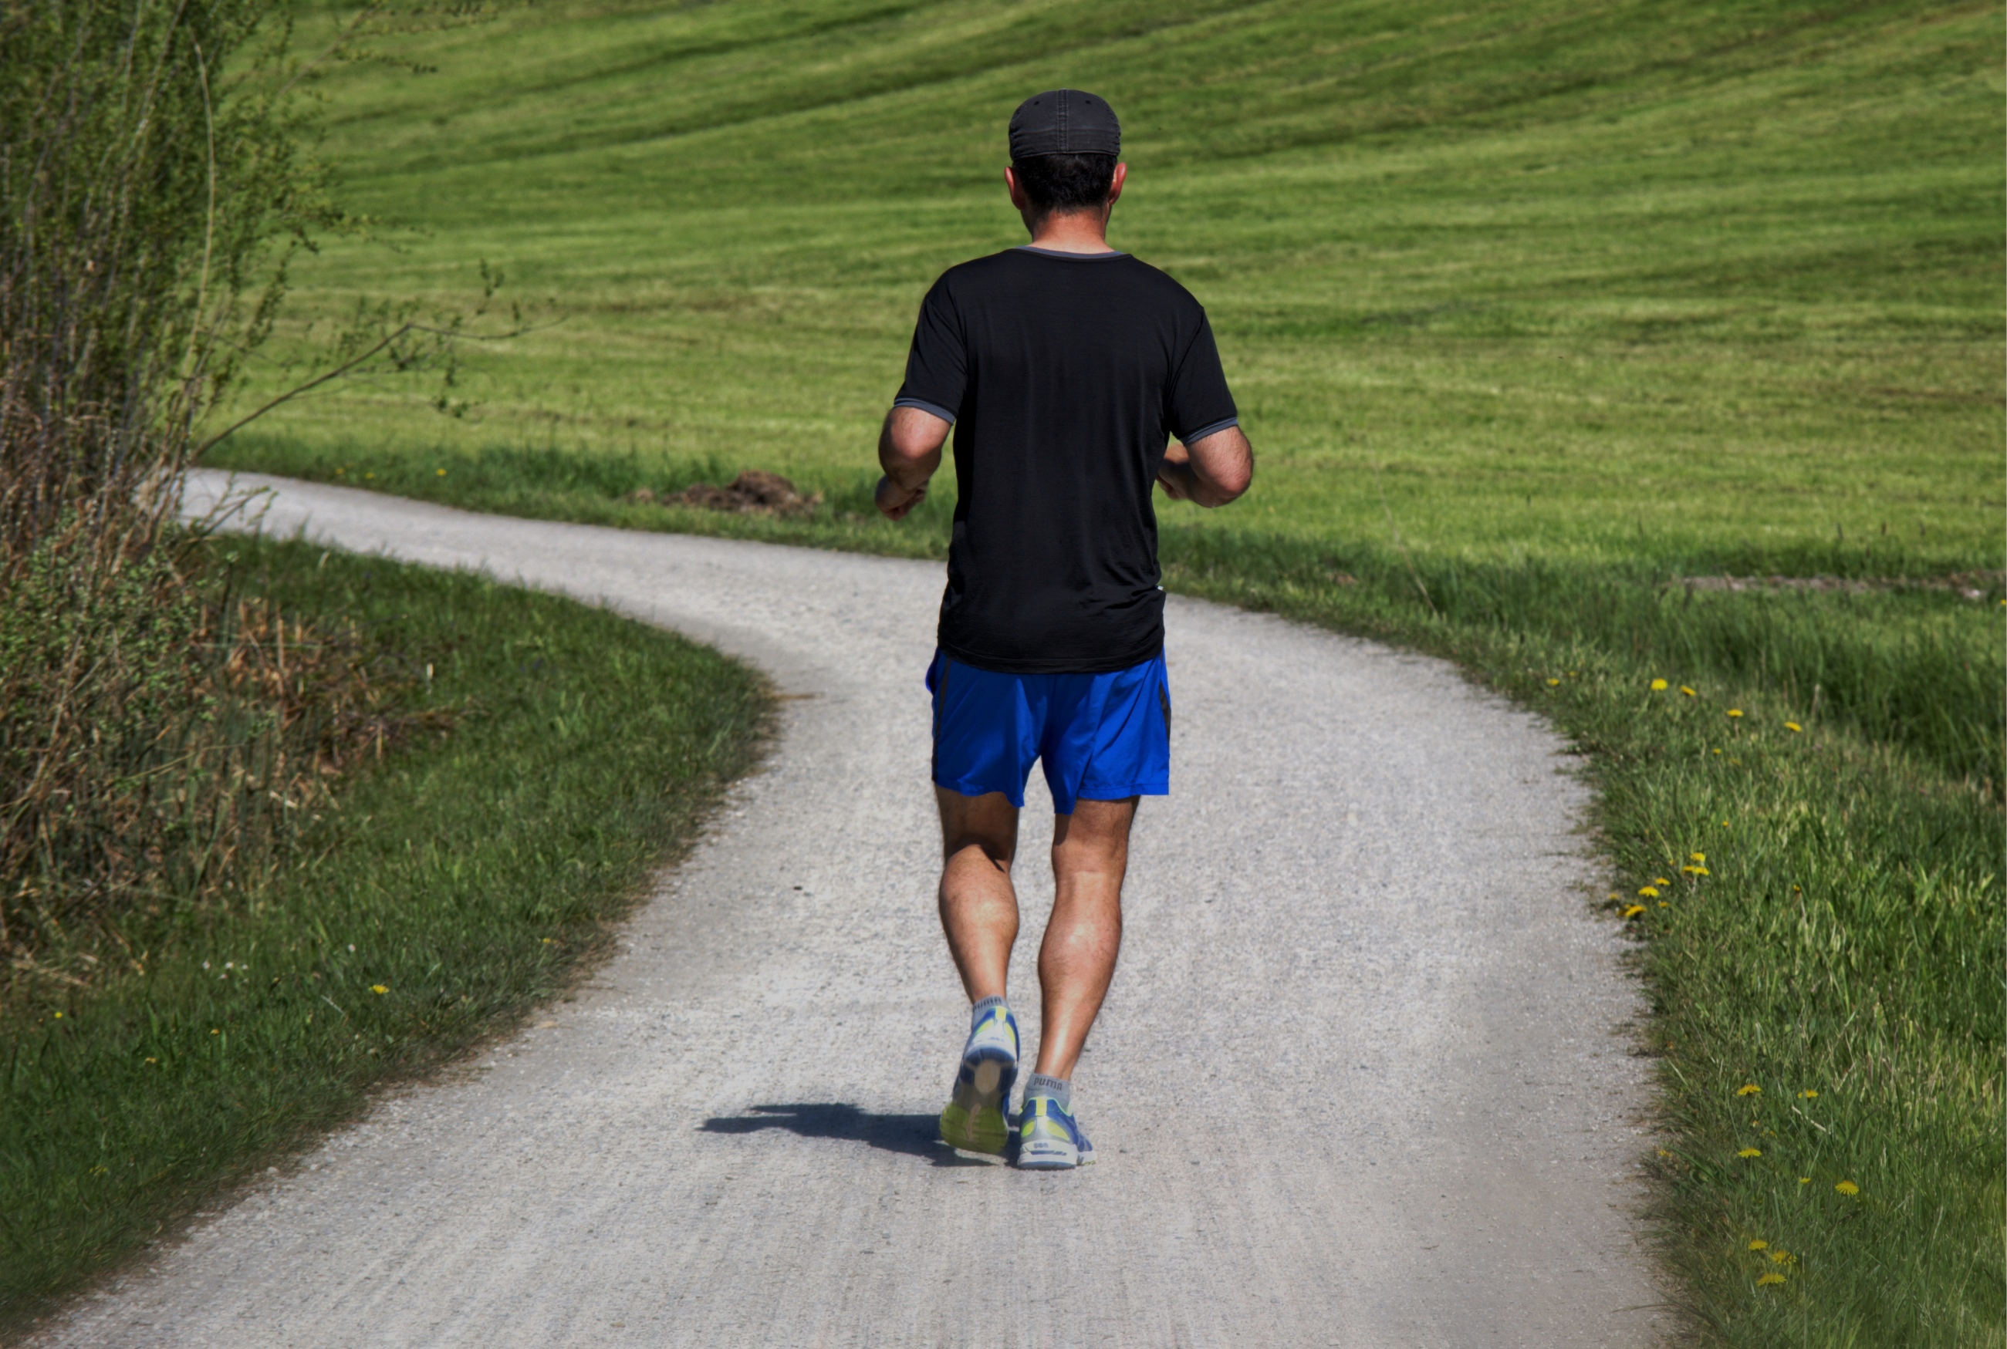
E-TALKING BEST FOR YOU
E-TALKING BEST FOR YOU
I go jogging this morning
view
Today’s teacher:

Slide 2

E-TALKING BEST FOR YOU
E-TALKING BEST FOR YOU
INTRODUCTION
CEF Learning Goals: To know how to use two verbs together.
To learn gerunds and infinitives.

Slide 3
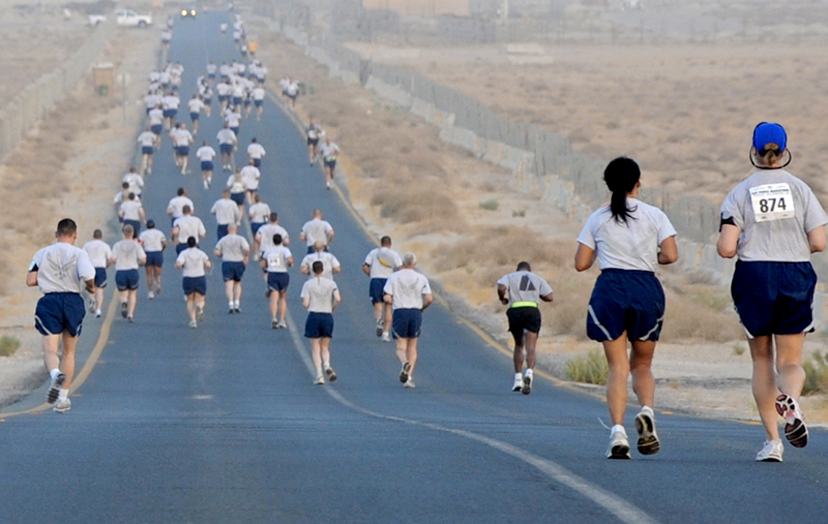
E-TALKING BEST FOR YOU
E-TALKING BEST FOR YOU
E-TALKING BEST FOR YOU
In this lesson, you will learn how to use two verbs together in one sentence.
START

Slide 4

E-TALKING BEST FOR YOU
E-TALKING BEST FOR YOU
E-TALKING BEST FOR YOU
WARM-UP
Did you go to work today?
Do you want to sing during the class?
What were you doing before?

Slide 5
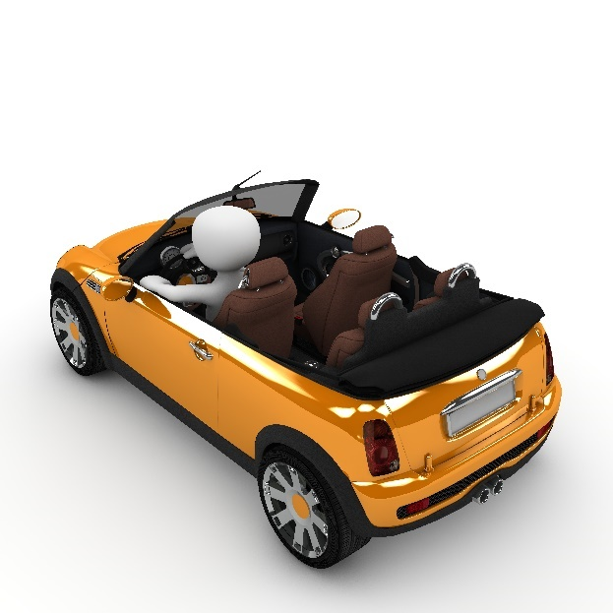
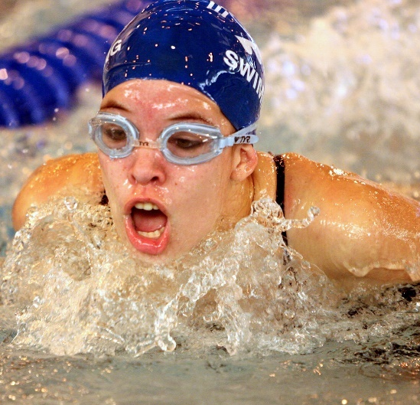
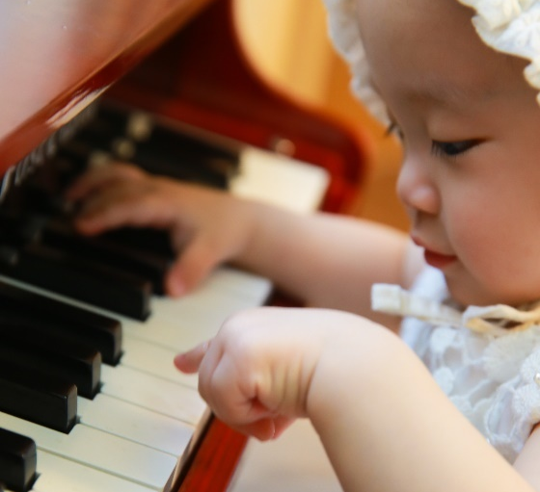
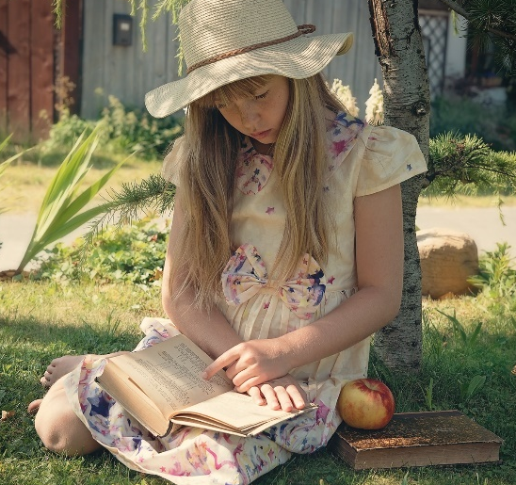

E-TALKING BEST FOR YOU
Match the pictures with their respective verbs.
E-TALKING BEST FOR YOU
a.
c.
__to swim
__to read
__to play the piano
__to drive
b.
d.
GETTING STARTED

Slide 6




E-TALKING BEST FOR YOU
01 Common Verbs + 'ing'
E-TALKING BEST FOR YOU
E-TALKING BEST FOR YOU
E-TALKING BEST FOR YOU
For example: I go to the park and jog. → I go jogging in the park.
I go swimming on Friday.
You enjoy shopping.
He quits drinking.
She practices playing the violin at home everyday.
The bird keeps singing.
To enjoy
To quit
Mon. – Sun. → 7pm- 8 pm
9 am - 6 pm
To practice
To keep

Slide 7







E-TALKING BEST FOR YOU
01 Common Verbs + 'ing'
E-TALKING BEST FOR YOU
E-TALKING BEST FOR YOU
Open a new coffee shop?
We will discuss opening a coffee shop.
You finish studying at 10 pm.
They consider buying a fan or an air conditioner.
To finish
To discuss
?
?
To consider

Slide 8

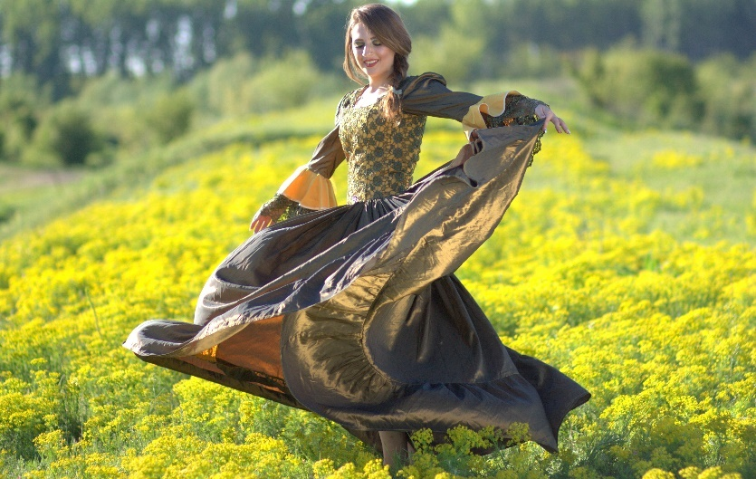
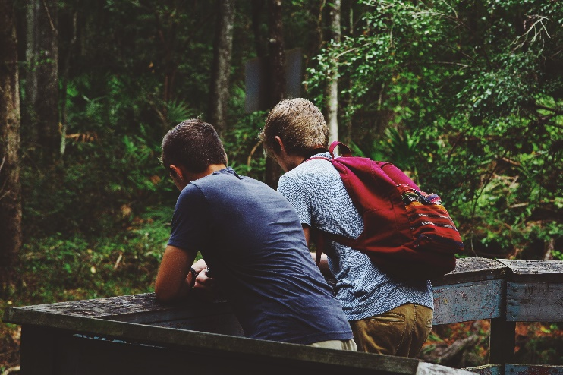

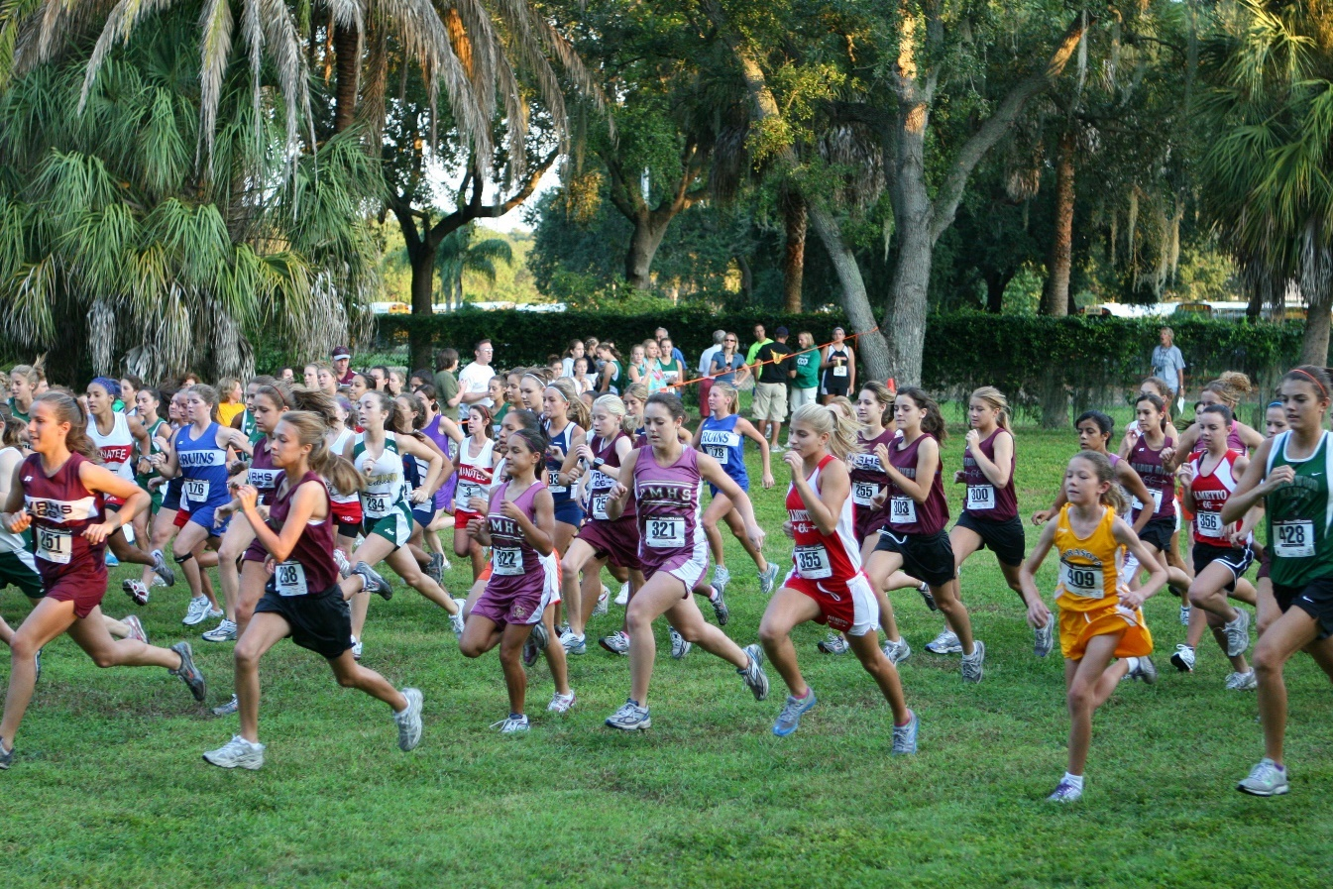

E-TALKING BEST FOR YOU
E-TALKING BEST FOR YOU
Practice
Observe the pictures and make sentences.
a.
b.
c.
Lillian, enjoy
We, go
Patrick, finish
They, keep
I, quit
d.
e.
01

Slide 9
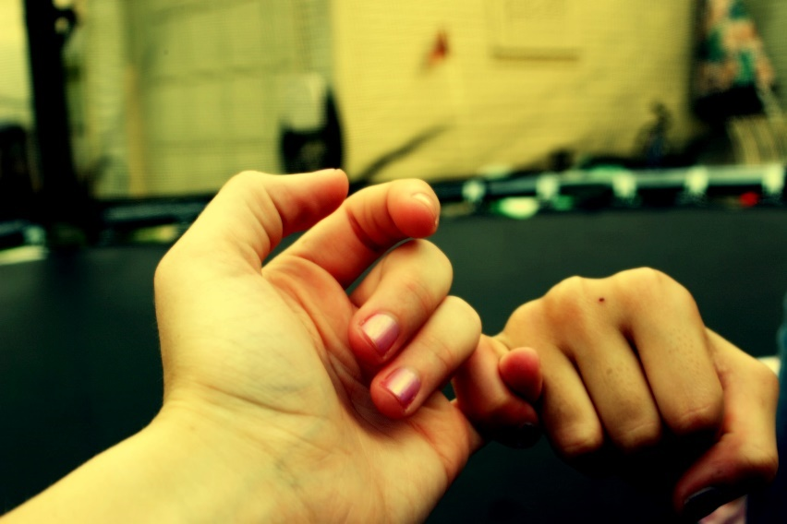
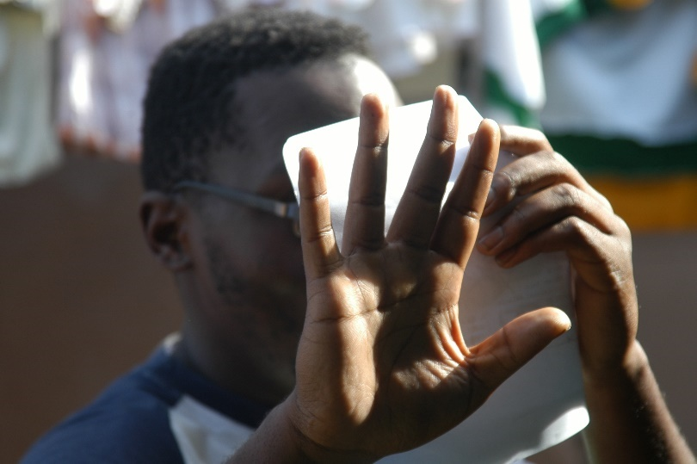

E-TALKING BEST FOR YOU
02 Common Verbs + to + Verbs
E-TALKING BEST FOR YOU
E-TALKING BEST FOR YOU
To promise
I promised to pay the bill.
You need to drink some water.
He refuses to take photos.
She plans to go to Canada this summer.
https://www.flickr.com/photos/hellokayla/2462794723
To refuse
Canada

Slide 10
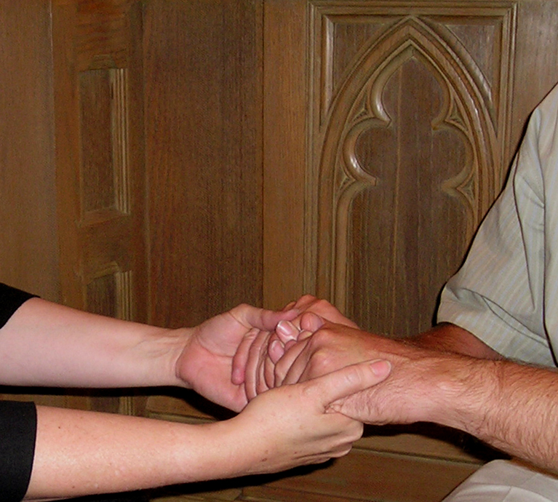



E-TALKING BEST FOR YOU
02 Common Verbs + to + Verbs
E-TALKING BEST FOR YOU
E-TALKING BEST FOR YOU
It wants to eat the ice cream.
We hope to have a baby.
You decide to go this road.
They learn to drive.
To hope
decide

Slide 11
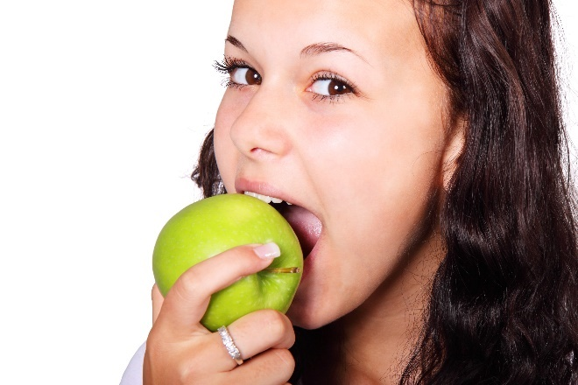
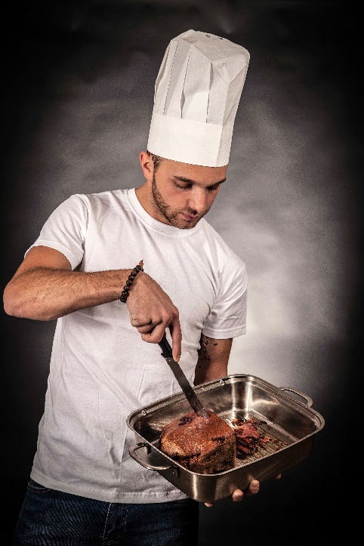




Practice
Look at the pictures and make sentences with “ to + verb”.
E-TALKING BEST FOR YOU
E-TALKING BEST FOR YOU
a.
b.
c.
You, refuse
Mike, promise
Naomi, decide
Judy and Sebastian, hope
The boy, learn
d.
e.
02

Slide 12

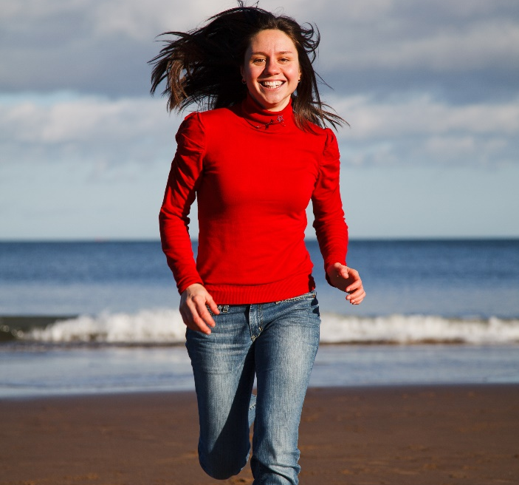
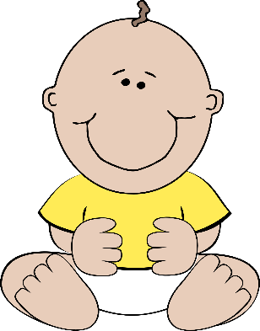

E-TALKING BEST FOR YOU
03 Verbs + “ing” vs. Verbs + to + Verbs
E-TALKING BEST FOR YOU
Same meanings:
Amy hates doing reports. = Amy hates to do the report.
The baby starts crying now. = The baby starts to cry now.
I love going to the beach. = I love to go to the beach.
You like singing. = You like to sing.
meaning
To love going to the beach
To start crying
望 is hope.
9:55 am
Now (10 am)

Slide 13

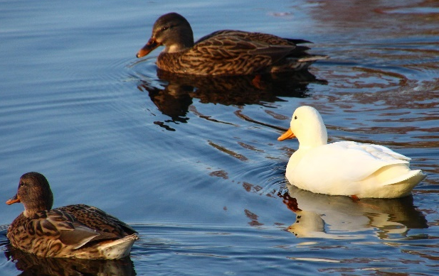


03 Verbs + “ing” vs. Verbs + to + Verbs
E-TALKING BEST FOR YOU
E-TALKING BEST FOR YOU
same
different
Different meanings:
To remember
Andy remembered turning off the light.
Andy, remembered to turn off the light.

Slide 14

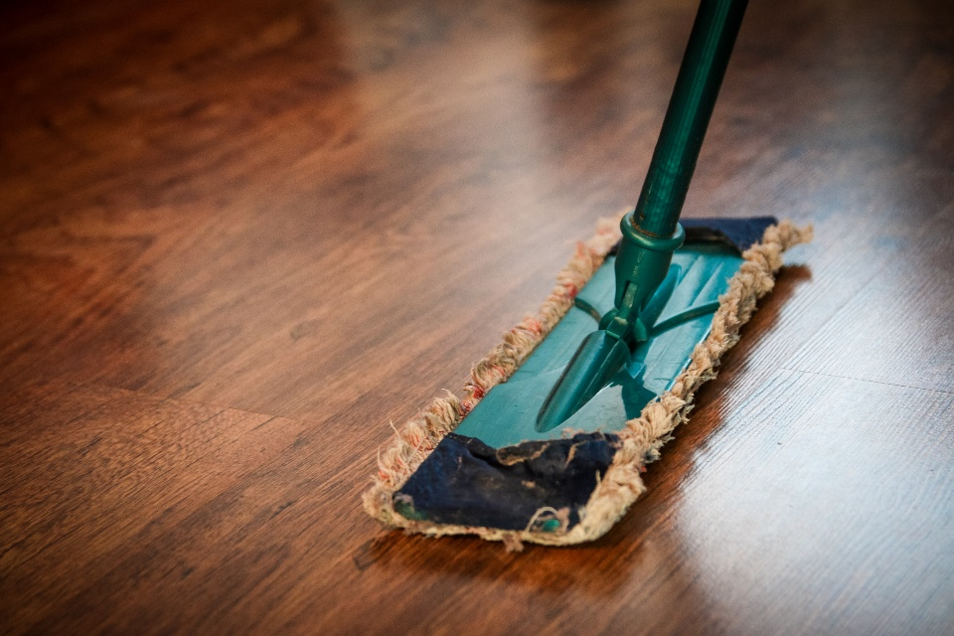

E-TALKING BEST FOR YOU
03 Verbs + “ing” vs. Verbs + to + Verbs
E-TALKING BEST FOR YOU
To forget
Different meanings:
She forgets cleaning the room.
The room is dirty. She forgets to clean the room.
clean
dirty

Slide 15


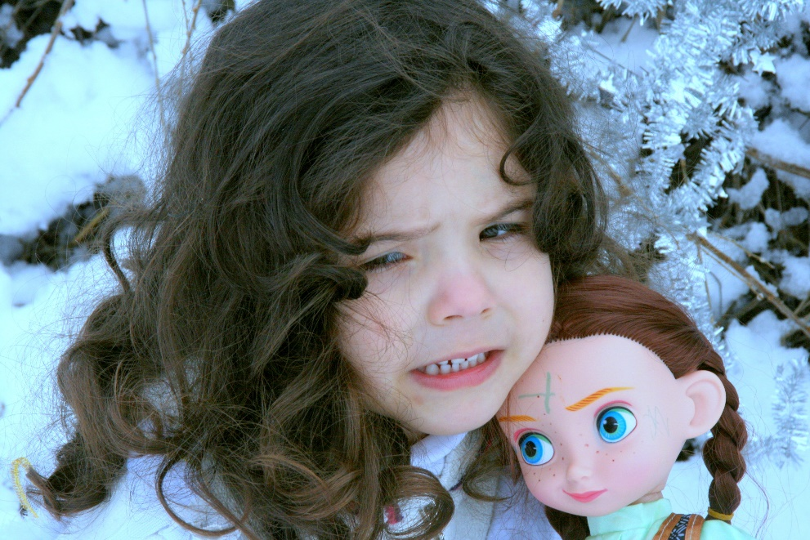
E-TALKING BEST FOR YOU
03 Verbs + “ing” vs. Verbs + to + Verbs
E-TALKING BEST FOR YOU
To regret
Different meanings:
Bob regrets stealing money.
Bob regrets to tell her a scary story. She is crying.

Slide 16
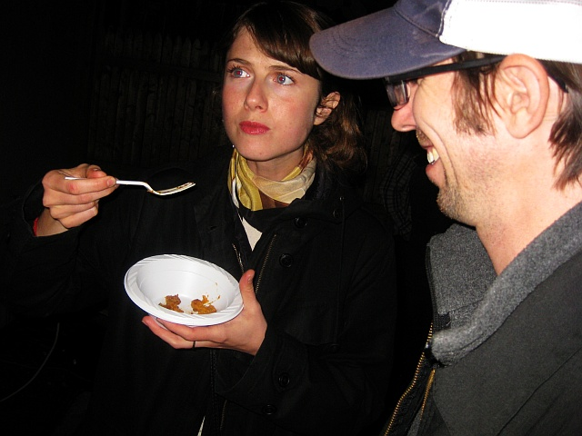
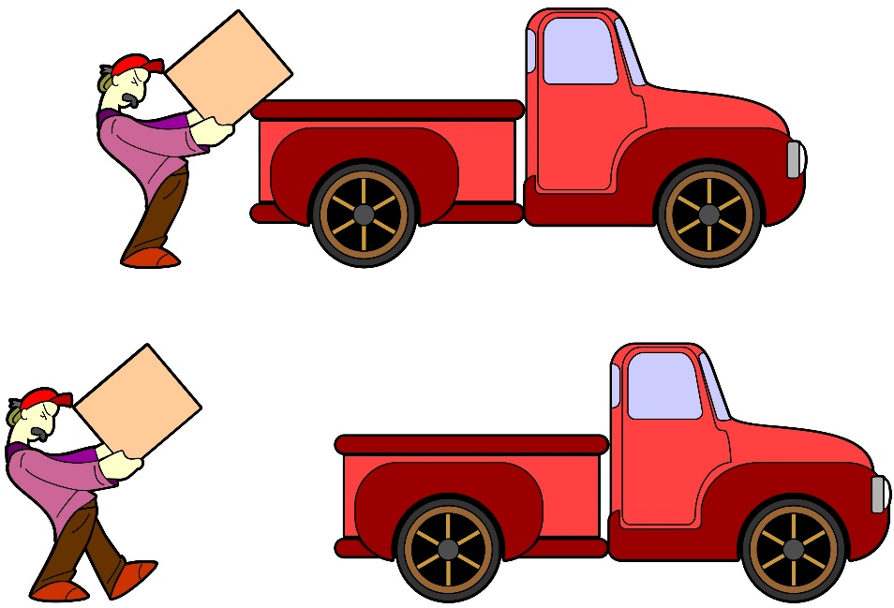
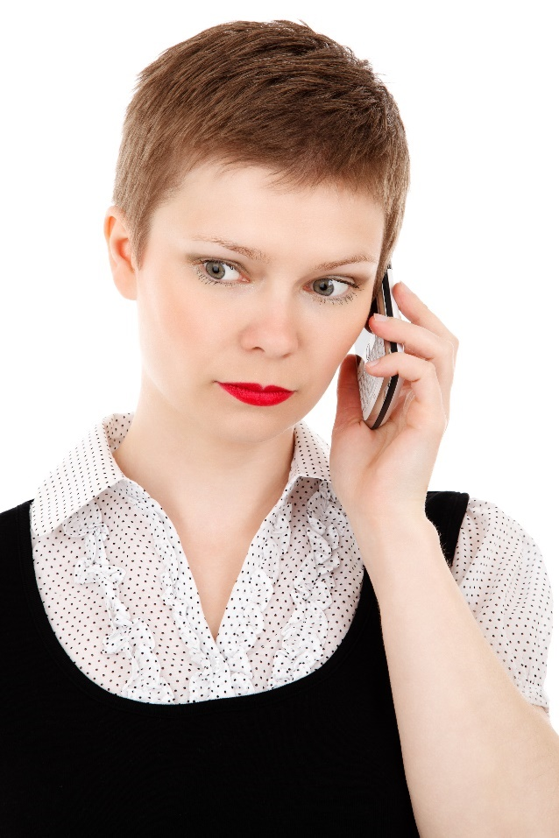
E-TALKING BEST FOR YOU
03 Verbs + “ing” vs. Verbs + to + Verbs
E-TALKING BEST FOR YOU
To try
Different meanings:
https://www.flickr.com/photos/mesohungry/3001686594
He tried to move the heavy box.
Emma isn’t at home. Try calling her cellphone!

Slide 17
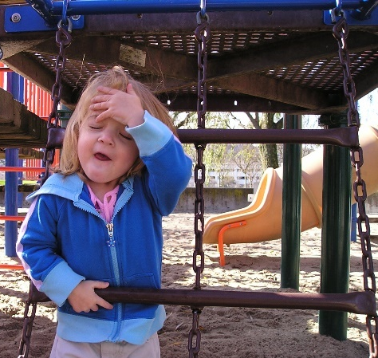



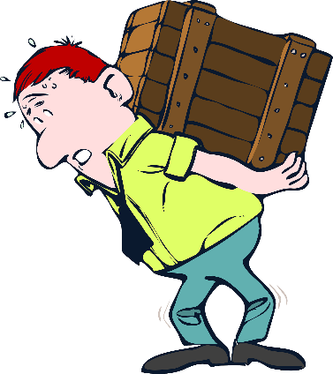

Practice
Look at the pictures and make sentences with “ to + verb”.
E-TALKING BEST FOR YOU
E-TALKING BEST FOR YOU
a.
b.
c.
Yesterday 12 pm
The girl, forget
Nick, regret
Charlotte, remember
Joseph, try
The women, love
Last night
d.
e.
tea
03

Slide 18

E-TALKING BEST FOR YOU
E-TALKING BEST FOR YOU
E-TALKING BEST FOR YOU
Pronunciation the:
the + consonants → /tə/: the ball, the tree, the cat, the lemon
the + vowels → /tɪ/: the apple, the elephant, the orange, the umbrella
PHONICS

Slide 19
E-TALKING BEST FOR YOU
E-TALKING BEST FOR YOU
Practice
Say it!
The ice cream
The sheep
The ant
The window
04

Slide 20
E-TALKING BEST FOR YOU
E-TALKING BEST FOR YOU
REVIEW
Circle the correct words.
1.The dishes are clean. Nina remembered to clean/cleaning them last night.
2. Kate and John love make/to make cakes.
3. They discussed being/to be a doctor.
4. Rose hopes marrying/to marry a singer.
5. The cat refuses to eat/eating bananas.
6. We consider wrote/writing a book.

Slide 21

E-TALKING BEST FOR YOU
E-TALKING BEST FOR YOU
SPEAKING TASK
1. List 5 words you learnt in this lesson.
2. Make 5 sentences with “Verbs + ing” or “Verbs + to + Verbs” and tell your teacher your sentences.

Slide 22

E-TALKING BEST FOR YOU
E-TALKING BEST FOR YOU
E-TALKING BEST FOR YOU
ASSESSMENT
Fill in the blanks.

Slide 23

E-TALKING BEST FOR YOU
practice/stealing/decide/didn’t/to open/diving/enjoyed/forgot
E-TALKING BEST FOR YOU
Daniel ________ hate to ride a motorcycle.
Betty _______ to work in the post office.
Amada and Alan went ______ last summer.
Johnny wants ______ a bookstore.
We regretted ______ his computer.
Alice ________ to buy the ticket. She can’t see the movie in the cinema.
I learnt French last week. I need to _______ speaking French.
William and Nicole _______ listening to the music.
ASSESSMENT

Slide 24


E-TALKING BEST FOR YOU
E-TALKING BEST FOR YOU
Thank you !

